Slide 1
SAMHAR-COVID-19 Hackathon
Diagnosing and Staging COVID-19 using AI-based Medical Imaging (CT Scans and X-Rays)
Harini N, harininarasimhan123@gmail.com
Ramji B, ramji.b28@gmail.com
Simran K, simiketha19@gmail.com
Vyshnav M T, vyshnav94.mec@gmail.com
Turaga Tulasi Sasidhar, sasidharturaga@gmail.com

Slide 2
PROBLEM STATEMENT
Diagnosing and Staging COVID-19 using AI-based Medical Imaging (CT
Scans and X-Rays)
Radiologists have watched the coronavirus disease 2019 (COVID-19) pandemic unfold. Radiology literature suggests a pivotal role for CT/X-RAY as CT/X-Ray findings in COVID-19 patient has pneumonia, and hence medical imaging has a high sensitivity for the diagnosis of COVID-19. The objective of this statement is to figure out the usage of AI in medical imaging modalities for fast and accurate diagnosis of COVID-19

Slide 3
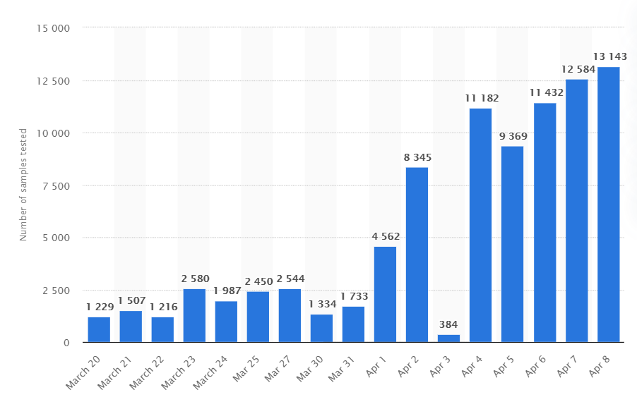
UNDERSTANDING THE PROBLEM
The diagnosis of COVID-19 is currently performed by a reverse-transcription polymerase chain reaction (RT-PCR) test on blood samples of patients.
The gold standard test for COVID-19 makes a progressive increase in the number of tests taken as shown in the image, but the increase rate can be further improved by a faster diagnosis using CT scans/X-Rays.
COVID-19 Test Statistics in India

Slide 4
OBJECTIVE
To deliver faster, cheaper and reliable diagnosis using X-Ray and CT scan images.
To classify the staging of disease in patients.

Slide 5
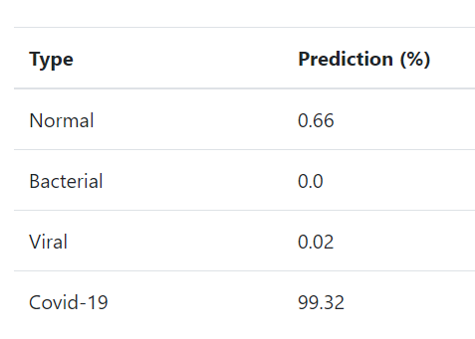
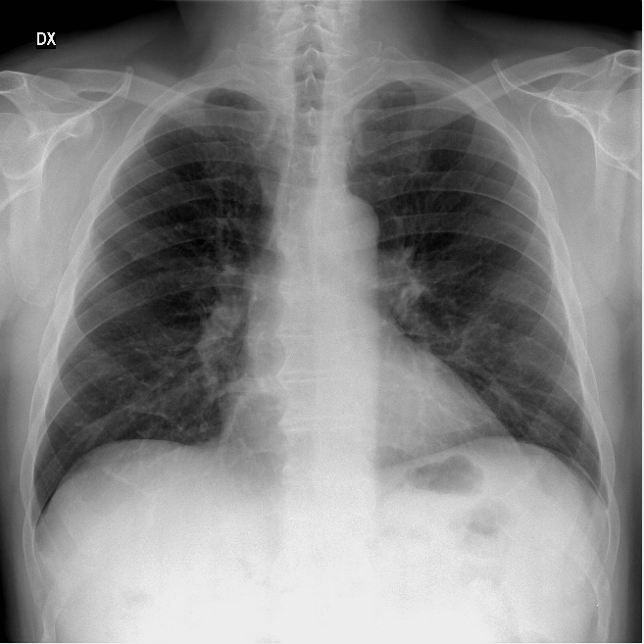
PROPOSED SOLUTION
Diagnosing and Staging COVID-19 using AI-based Medical Imaging (CT
Scans and X-Rays)
Deep Learning Model

Slide 6
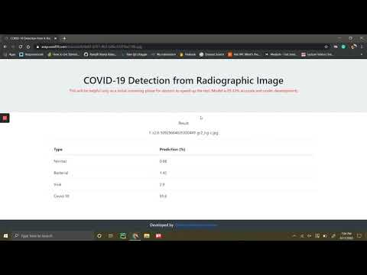
PROPOSED SOLUTION
https://xraycovid19.com/

Slide 7
REQUIREMENTS
CT scan and X-Ray image dataset to improve the model performance
Stage wise covid-19 annotated dataset to classify.
GPU to train the model
Mentor for medical reasoning and ML model fabrication

